Slide 1

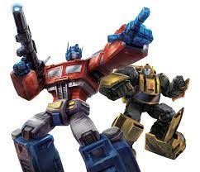
BERT and Transformers
Amos Azaria

Slide 2
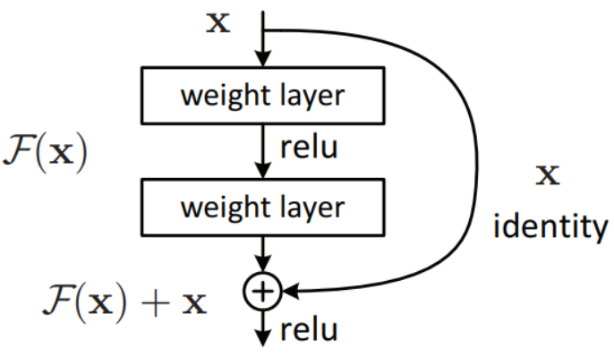
Residual connection
Skip connections:
allow the gradients to flow from start to end without passing through the residual connections.
Very helpful for deep networks.
The network can first learn the basic properties of the data (and output values close to 0 for the residual layers), and then, once it performs better, further tune the parameters in the residual layers.
Generally, performs better than adding layers sequentially (as was previously done).

Slide 3
Homonyms in word embeddings
Words with multiple meaning (homonyms) have a single vector in word2vec (regardless of their meaning). E.g.: bat, bank, bark.
The real meaning usually depends on the context.
Any word may have a slightly different meaning depending on its context.
How can we take the context into account?

Slide 4
Word embeddings with context
Note that each word-vector has 3 roles!
Once when used as the query (‘bat’ in our example), once when used to compute the distance from the it (key), and once when used to compute the final vector (value)
Note that words related to flying have a low first value and high last value, where words related to games have high first and low last.
So, when bat means the animal, we want a low first value and a high last value, and vice-versa when bat means the game item.
[1,6,0,9][3,1,6,6][1,5,7,7][0,4,4,7][6,4,1,4][7,6,6,0]
[7,9,7,5] [8,5,3,9] [4,1,8,3] [9,0,2,1] [3,2,7,2] [7,0,8,1] [9,0,2,1][3,1,6,6]
A bat flew above my head
She successfully hit the ball with the bat
E.g., 50% for “bat” and 50% for the mean
50%
50%
[3, 2.67,5,5.75]
[4.6, 1.6, 5.7, 4.75]
We want to give more weight (attention) to more relevant words:
We determine the weight using cos similarity (dot product of vectors divided by their norms, and then using softmax)
cosine:
[0.64 1. 0.91 0.86 0.69 0.63]
[0.78 0.83 0.92 0.54 0.88 0.77 0.53 1.]
Attention:
[0.02, 0.57, 0.24, 0.14, 0.03, 0.01]
[0.06, 0.09, 0.2, 0. , 0.14, 0.05, 0. , 0.46]
Final embedding:
[2.21, 2.59, 5.74, 6.28]
[4.1 , 1.87, 6.41, 4.74]
Notes:
Cosine values were multiplied by 10, before applying softmax

Slide 5
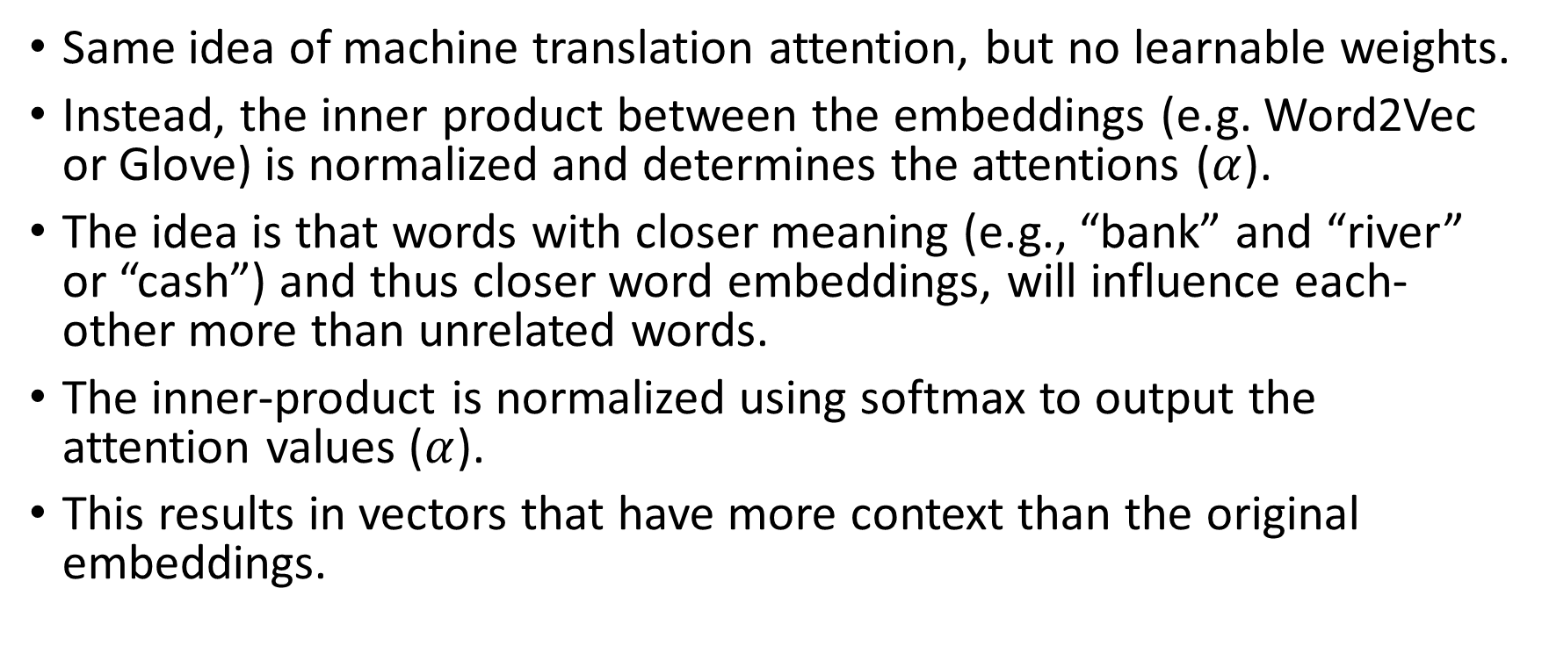
Weightless self-attention
Same idea of machine translation attention, but no learnable weights.
Instead, the inner product between the embeddings (e.g. Word2Vec or Glove) is normalized and determines the attentions ($α$).
The idea is that words with closer meaning (e.g., “bank” and “river” or “cash”) and thus closer word embeddings, will influence each-other more than unrelated words.
The inner-product is normalized using softmax to output the attention values ($α$).
This results in vectors that have more context than the original embeddings.
Notes:
Reminder – the inner product of two vectors v and u is vTu. Or simply multiplying and adding all the terms.

Slide 6
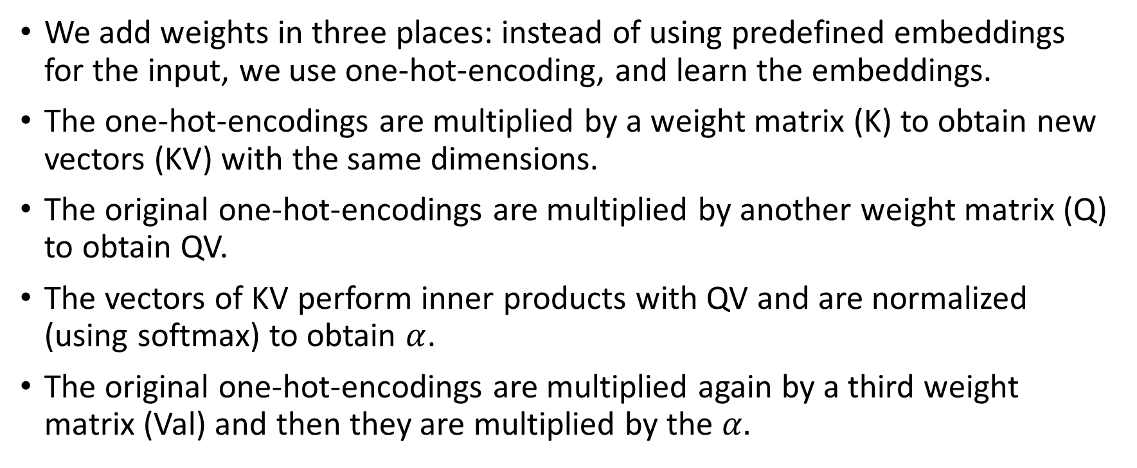
Adding weights (self-attention)
We add weights in three places: instead of using predefined embeddings for the input, we use one-hot-encoding, and learn the embeddings.
The one-hot-encodings are multiplied by a weight matrix (K) to obtain new vectors (KV) with the same dimensions.
The original one-hot-encodings are multiplied by another weight matrix (Q) to obtain QV.
The vectors of KV perform inner products with QV and are normalized (using softmax) to obtain $α$.
The original one-hot-encodings are multiplied again by a third weight matrix (Val) and then they are multiplied by the $α.$
What are the dimensions of this matrix?
Notes:
If the input is k x t, the matrix must be k x k (we multiply from the left).

Slide 7
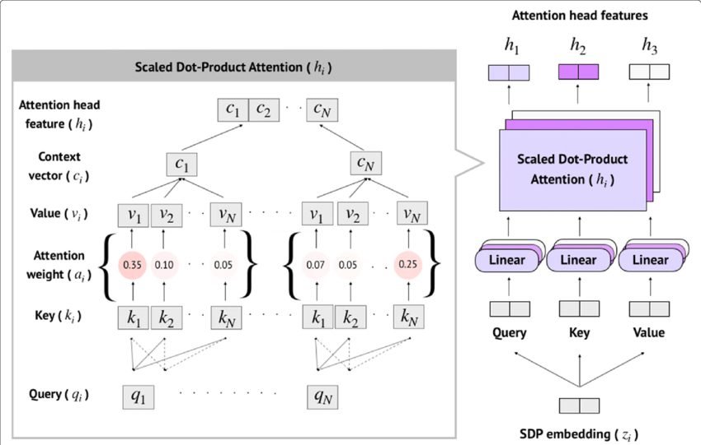
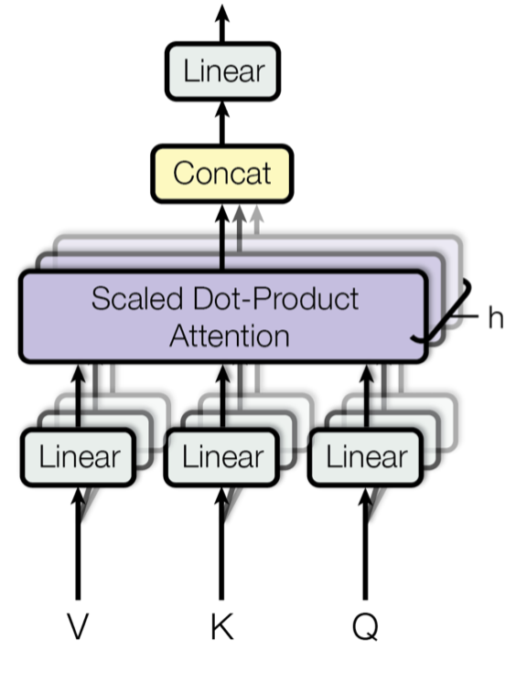
Multi-Head Attention
Simply stacking multiple channels of self-attention (using multiple matrices).
Credit: https://www.researchgate.net/figure/llustration-of-Multi-Head-attention-mechanism-to-encode-SDP-embeddings-which-consists-of_fig2_337782552
Credit: Vaswani, Ashish, et al. "Attention is all you need." NeurIPS 2017

Slide 8
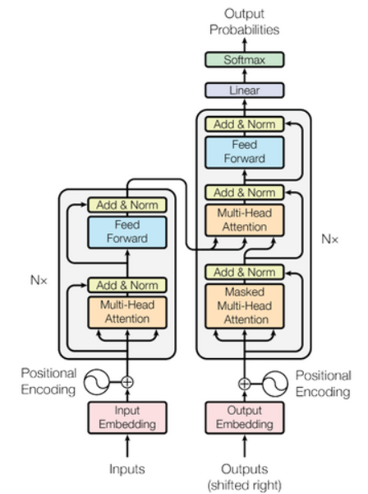
Transformers (for MT)
The positional encoding adds a different value to each vector depending on its location in the original sentence.
This positional encoding can be learned or based on a mathematical function (e.g., sin/cos).
Skip connections
Credit: Vaswani, Ashish, et al. "Attention is all you need." NeurIPS 2017
Notes:
Embeddings are basically a look-up matrix that is being learned (which is equivalent to a one-hot-encoding of the words with a single hidden layer)
(see https://datascience.stackexchange.com/questions/73189/does-bert-use-glove)

Slide 9
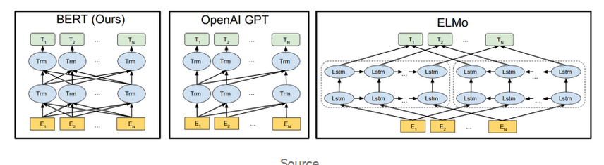
BERT (Bidirectional Encoder Representations from Transformers)
Uses a very limited vocabulary size (only 30,000), so some words are split into several tokens (e.g., “playing” -> “play”, “##ing”).
Maximum sentence length (N) is 512 tokens.
The weights in each row of transformers are identical (just like LSTMs)
Source: Devlin, Jacob, et al. "Bert: Pre-training of deep bidirectional transformers for language understanding." arXiv preprint arXiv:1810.04805 (2018).

Slide 10
Training BERT
In the corpus. Not 15% of the tokens in the dictionary.
Trained using unsupervised learning:
15% of the tokens in the entire corpus are marked:
80% of the marked tokens are replaced with a mask token.
10% of the marked tokens are replaced with a random token.
10% of the marked tokens remain the same (but are still marked).
The model is required to output the original sentence.
However, the loss is computed using the marked tokens only (regardless of if they were masked, replaced or left untouched).

